Slide 1
This document requires the following fonts: Nunito Roboto Slab These can be downloaded from https://fonts.google.com/ “Save As” PNG files to export

Slide 2



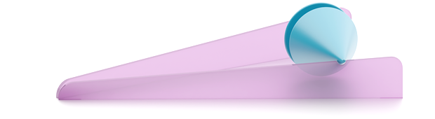

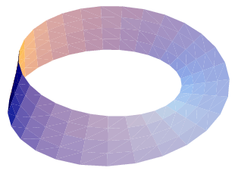
Uphill Roller
Place the roller on the slope and let go.
Does it roll up or down the slope?
Why does the roller roll up the slope? Hint: Why do things move down a slope? Is the final height of the roller above or below its initial height?
Scan for mechanical explanation!
➔
Please place the roller in the holder when you’re done ☺
Stop 1
of 8
Centre of Mechanics
Mechanics Fun Walk
Next stop: UCD Quinn School of Business

Slide 3
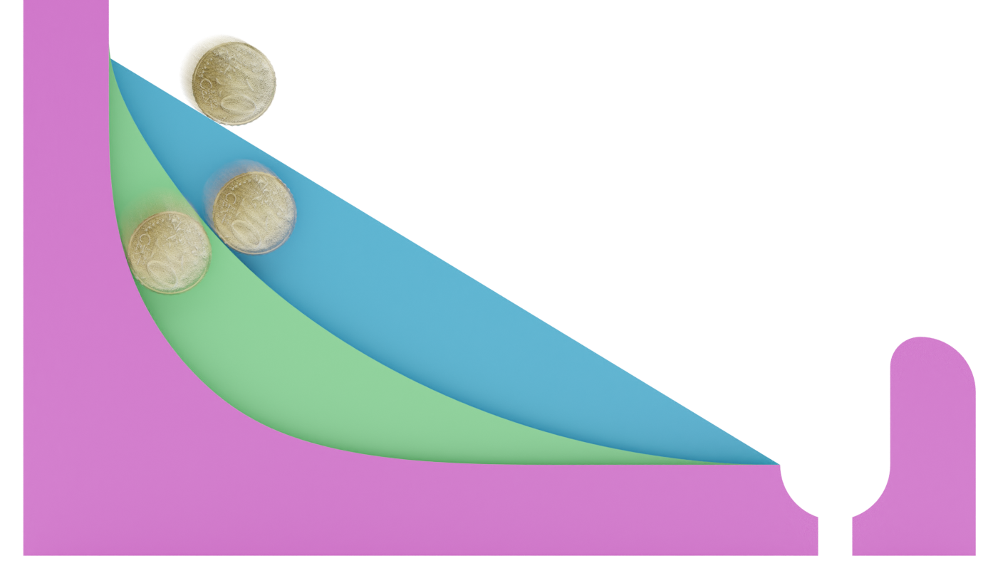

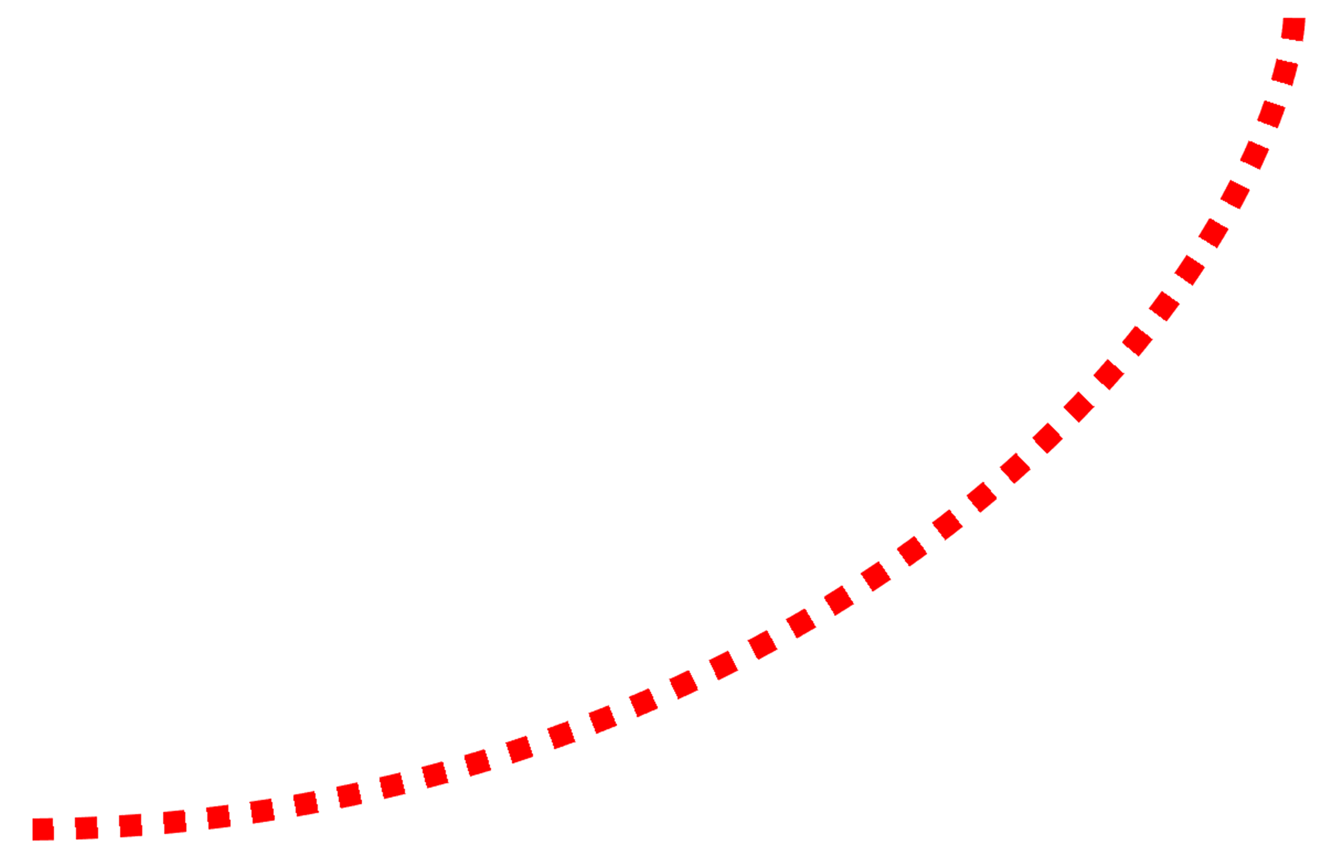


Brachistochrone Problem
The Brachistochrone is the curve of fastest decent between points A and B.
A
B
300 years ago, it took the greatest scientists to solve the Brachistochrone.
The fastest curve was found to be a cycloid.
Spin the knob clockwise to move the wheel from right to left.
The marker on the wheel draws the cycloid – this is the fastest path – the Brachistochrone!
Stop 1
of 8
Centre of Mechanics
Mechanics Fun Walk
Next stop: UCD Quinn School of Business

Slide 4

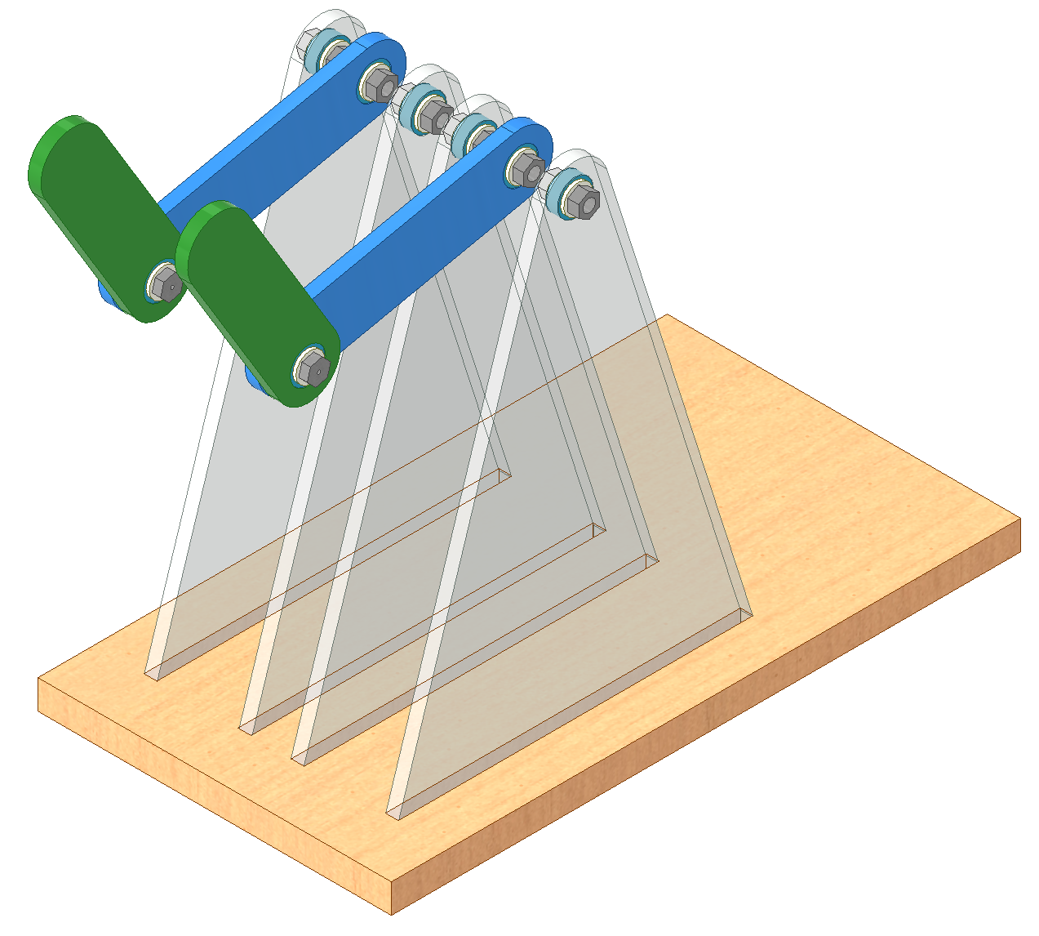
Chaotic Double Pendulum
Chaos in mechanics means unpredictable and extremely sensitive to “initial conditions”.
This means the slightest difference in the start of the system results in entirely different outcomes!
This makes predicting the outcome impossible.
This is the principle behind dice rolls and is termed the Butterfly Effect.
Start both double pendulums from the same starting position, as similarly as you can.
Let go and watch as the double pendulums take completely different trajectories!
Stop 1
of 8
Centre of Mechanics
Mechanics Fun Walk
Next stop: UCD Quinn School of Business

Slide 5
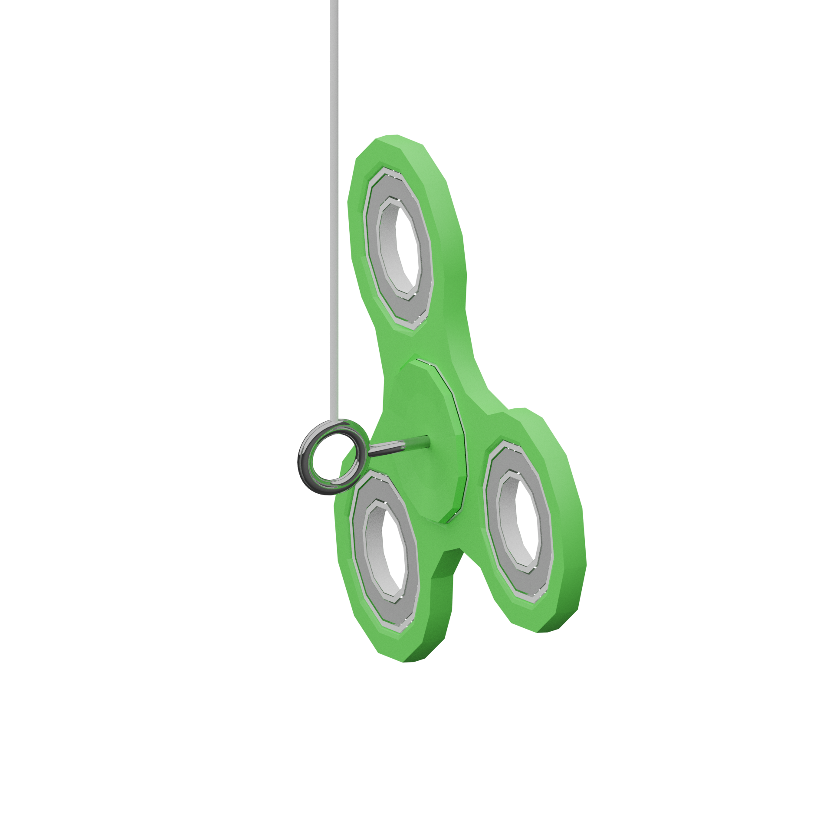
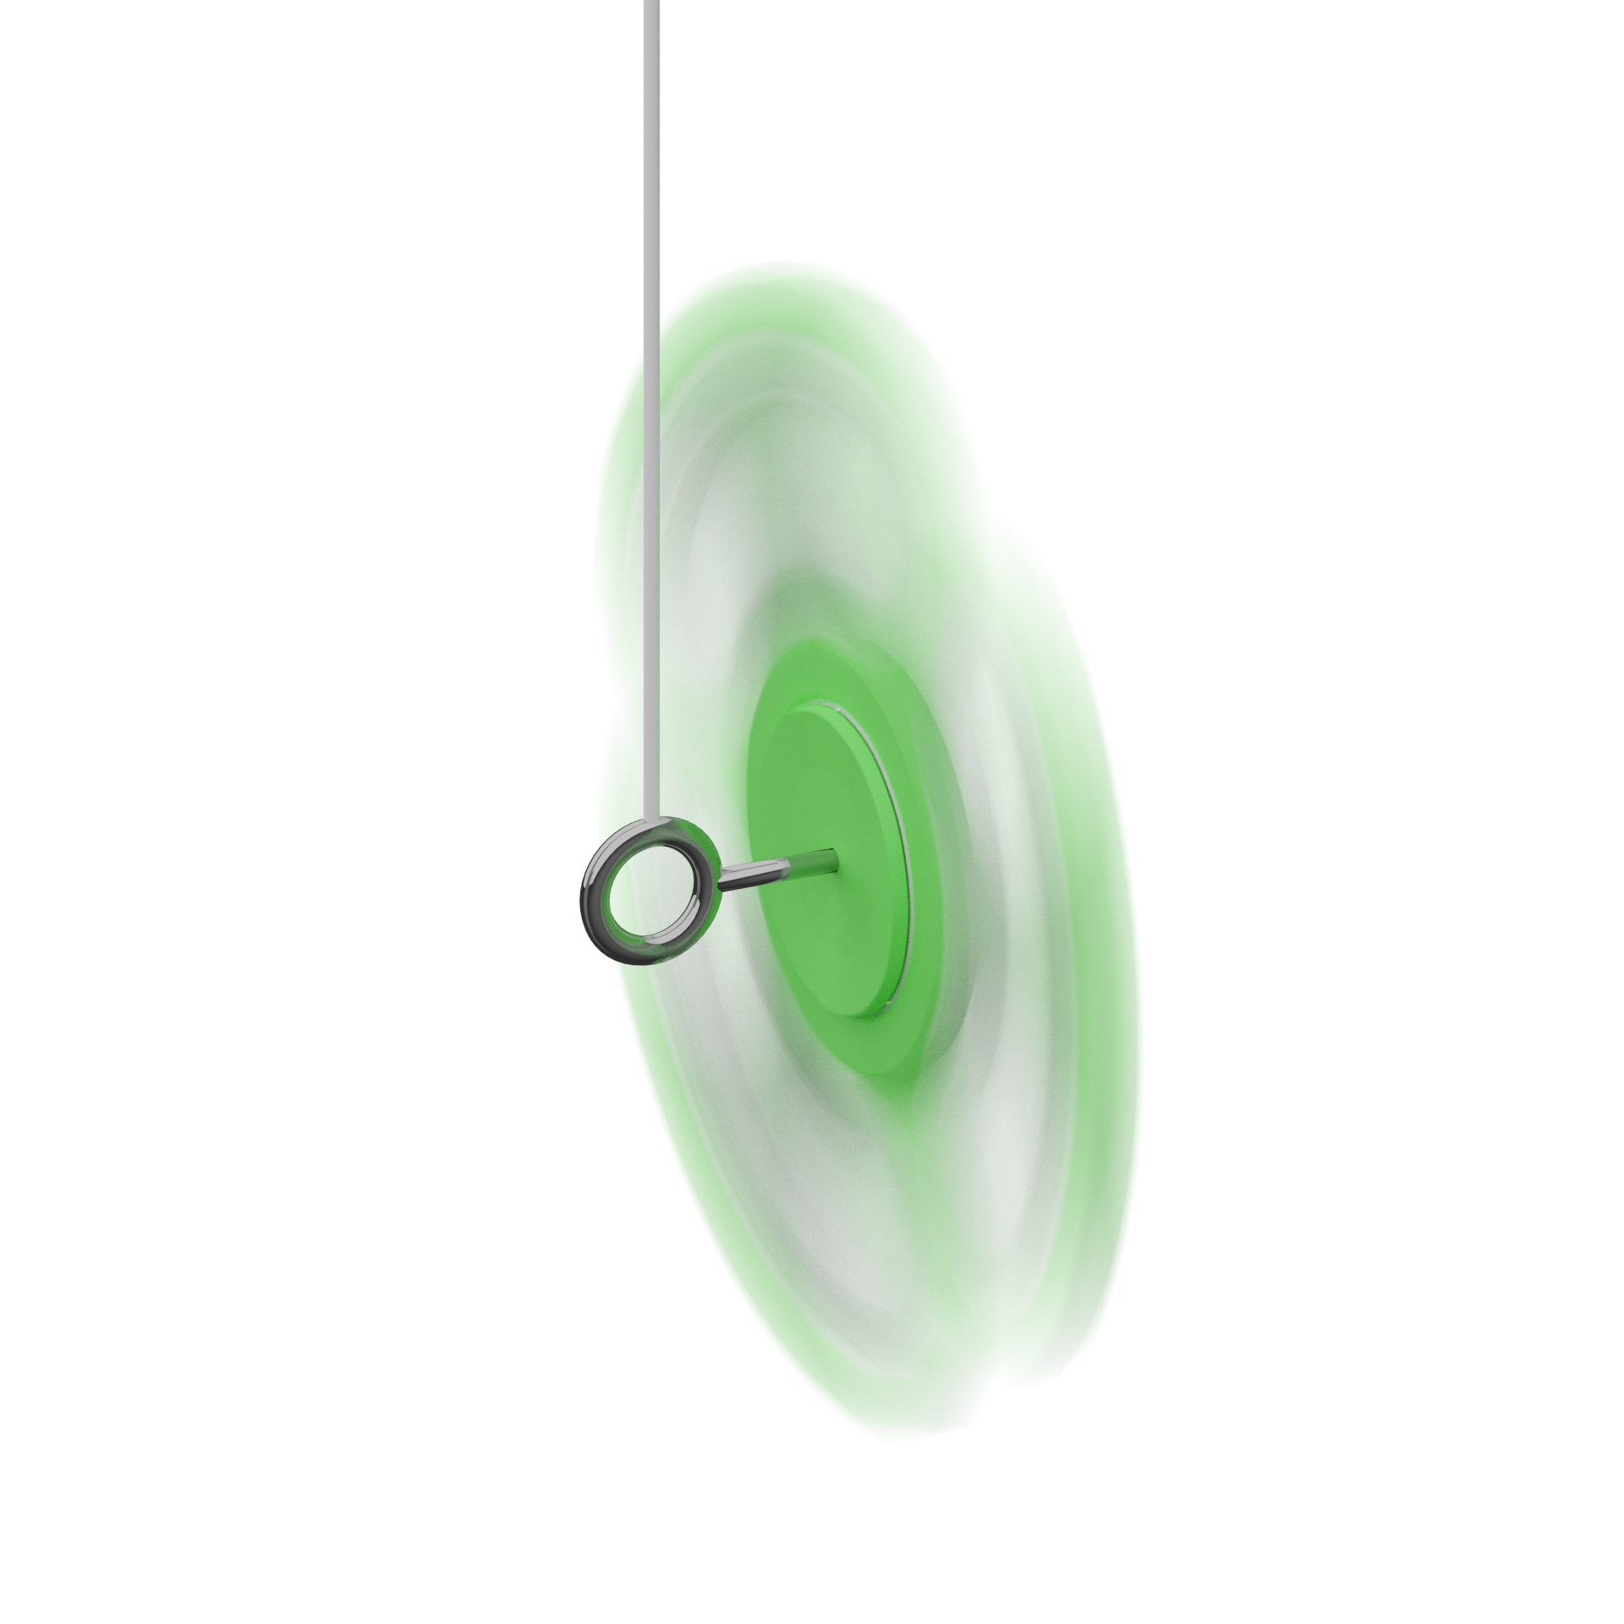
Gyroscopic Precession
Orientate the spinner 90° as shown above. Let go. Does it drop? Does it rotate around the vertical axis?
Spin the spinner as fast as you can!
Repeat Step 1. Does it drop? Does it rotate around the vertical axis?
Make sure the string is not loose when you release the spinner.
Scan for mechanical explanation!
➔
Stop 1
of 8
Centre of Mechanics
Mechanics Fun Walk
Next stop: UCD Quinn School of Business

Slide 6
Order from Chaos
Photos of before and after mixing
Toss the nails in the box to mix them up.
When they are well mixed, shake the box from side to side for a minute.
Watch the nails arrange themselves into order.
Scan for mechanical explanation!
➔
Stop 1
of 8
Centre of Mechanics
Mechanics Fun Walk
Next stop: UCD Quinn School of Business

